Slide 1
Brain Tissue Prediction

Slide 2
Agenda
Abstract
Scope and Motivation
Introduction
Objective
Problem Statement
Proposed Work
Module Description
Software & Hardware Requirements
References

Slide 3
ABSTRACT
Accurate prediction and classification of brain tissues are vital in diagnosing and treating neurological disorders. This project aims to develop a machine learning model capable of identifying and classifying different brain tissue types from MRI scans. The dataset utilized consists of MRI images labeled with various tissue types, including gray matter, white matter, and cerebrospinal fluid. To enhance the accuracy of predictions, extensive pre-processing techniques are applied to the MRI images to improve feature clarity and reduce noise.
The core of this project is the implementation of a convolutional neural network (CNN) model, designed to automatically extract relevant features from the pre- processed images. The CNN architecture is fine-tuned to achieve optimal performance in classifying brain tissues, with a focus on balancing accuracy and computational efficiency. The model's effectiveness is evaluated using standard metrics, and its potential applications in clinical settings are explored, highlighting its significance in advancing medical imaging and neurological diagnostics.

Slide 4
Scope and Motivation
Scope
The Brain Tissue Prediction project focuses on developing a machine learning model to classify different brain tissues, including gray matter, white matter, and cerebrospinal fluid, from MRI scans. The project includes data collection, image pre- processing, model training, and performance evaluation. The goal is to create a robust model that can accurately classify brain tissues and integrate seamlessly into clinical workflows to assist in neurological diagnoses.
Motivation
Accurate brain tissue classification is crucial for diagnosing neurological disorders like Alzheimer's, multiple sclerosis, and brain tumors. Traditional methods are often slow and prone to errors. This project aims to use machine learning to improve the accuracy and efficiency of brain tissue classification, ultimately enhancing diagnostic processes and patient outcomes in neurology.

Slide 5
Introduction
Advancements in medical imaging have significantly improved our understanding of the human brain, yet the accurate classification of brain tissues from MRI scans remains a complex challenge. Brain tissue classification is vital for diagnosing and monitoring neurological disorders such as Alzheimer's disease, multiple sclerosis, and brain tumors. Traditional methods rely heavily on manual interpretation by radiologists, which can be time-consuming and susceptible to human error.

Slide 6
This project aims to address these challenges by developing a machine learning model capable of automatically classifying brain tissues, including gray matter, white matter, and cerebrospinal fluid, from MRI images. By leveraging the power of convolutional neural networks (CNNs), the model seeks to enhance the accuracy and efficiency of tissue classification, providing a valuable tool for clinicians and researchers in the field of neurology. The integration of this technology into clinical practice has the potential to revolutionize the way neurological conditions are diagnosed and treated, offering more precise and timely insights into brain health.

Slide 7
Objective
Develop a machine learning model to accurately classify brain tissues from
MRI scans.
Focus on distinguishing between gray matter, white matter, and cerebrospinal fluid.
Enhance the precision and speed of brain tissue classification.
Aid in the early diagnosis of neurological disorders.
Improve patient outcomes through more accurate and timely diagnoses.
Ensure the model can be seamlessly integrated into clinical workflows.
Provide healthcare professionals with a reliable tool for informed decision- making in neurology.

Slide 8
Problem Statement
Accurate classification of brain tissues, such as gray matter, white matter, and cerebrospinal fluid, is crucial for diagnosing and treating neurological disorders. However, current methods for brain tissue classification from MRI scans are often time-consuming, prone to human error, and dependent on the expertise of radiologists. This variability can lead to inconsistent diagnoses, delayed treatments, and suboptimal patient outcomes.
The challenge lies in developing a machine learning model that can reliably automate the classification process, ensuring consistent, accurate, and efficient analysis of MRI images. Such a model must be capable of handling the complexities of brain imaging data, including variations in patient anatomy, MRI scan quality, and the presence of pathological conditions, while also being practical for integration into clinical settings.

Slide 9
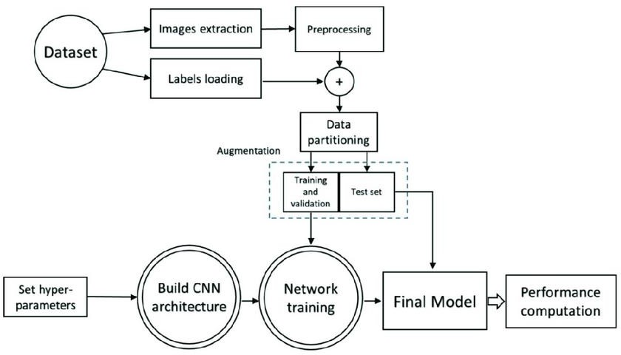
Proposed Work

Slide 10
Module Description
The Brain Tissue Prediction System aims to classify different brain tissues, such as white matter and gray matter, using machine learning techniques. The system begins with data preprocessing, which involves normalizing MRI scans, reducing noise, and segmenting brain regions to prepare the data for analysis.
For model development, deep learning algorithms, such as convolutional neural networks (CNNs), are employed to extract features from the MRI data, followed by training and validation to ensure accuracy. The system then classifies the brain tissues and provides visual predictions on MRI scans, evaluated using accuracy metrics.
Once developed, the system is deployed in clinical settings with an intuitive user interface, making it accessible for healthcare professionals. It supports diagnostic processes and contributes to medical research. Future enhancements include improving model accuracy and extending capabilities to other imaging modalities.

Slide 11
Software & Hardware Requirements
Software:
OS: Windows, macOS, or Linux (Ubuntu preferred)
Languages: Python
Frameworks: TensorFlow or PyTorch
Libraries: NumPy, pandas, Matplotlib, OpenCV
Tools: Jupyter Notebook, Git
Deployment: Docker (optional), Flask or Django (for web interface)
Hardware:
CPU: Multi-core (Intel i5/i7 or AMD Ryzen 5/7)
RAM: 16 GB (32 GB recommended)
Storage: 500 GB SSD (plus external/cloud storage for large datasets)
GPU: NVIDIA GPU with CUDA support (e.g., GTX 1660 or RTX 20xx)
Network: Stable internet connection

Slide 12
References
Research Papers:
"Brain Tissue Classification Using Deep Learning Techniques"
Overview of deep learning methods for brain tissue classification.
"A Survey of Machine Learning for Brain Imaging"
Survey on ML applications in brain imaging.
"Deep Learning for Brain MRI Classification: A Review"
Review of deep learning approaches for MRI classification.
Datasets:
ADNI (Alzheimer's Disease Neuroimaging Initiative)
MRI dataset for brain imaging.
ADNI Database
OASIS (Open Access Series of Imaging Studies)
MRI data for aging and brain disorders.
OASIS Database
Books and Tutorials:
"Deep Learning for Medical Image Analysis"
Overview of deep learning in medical image analysis.
"Hands-On Machine Learning with Scikit-Learn, Keras, and TensorFlow"
Practical guide for machine learning and image analysis.

